Slide 1
Analysis of Global Internet Usage Trends
Programming for Data Analytics 04638-A

Slide 2

Introduction
This presentation explores the global internet usage trends from 2000 to 2021, using data sourced from the United Nations¹.
Objectives
Understand the dataset
Define analytics objectives
Analyze variables and their relationships
Prepare and clean the data
Perform in-depth exploratory analysis
Communicate key insights
1. https://data.un.org/_Docs/SYB/CSV/SYB66_314_202310_Internet%20Usage.csv

Slide 3
Group 12
Mustapha Olalekan Alaba
(malaba)
Candide Giramata Muhoracyeye
(mgiramat)
Jonathan Kayizzi
(jkayizzi)

Slide 4
Analysis Process
Data Sourcing
Dataset downloaded from UNdata
Data Preparation
Data cleaning, column manipulation and records extraction.
Exploratory Data Analysis
Summary and descriptive statistics, univariate, bivariate and multivariate visualizations.
Insights
Insights from exploration and answers to preliminary questions
Cursory Examination
The data was viewed in excel and preliminary questions generated

Slide 5

Preliminary Questions
What is the average internet usage percentage for all countries
How does the data distribution of internet usage percentages change over the years
How has the global percentage of individuals using the internet changed over time.
Which regions or countries have shown the most significant increase in internet usage
Are there any notable outliers in terms of internet usage, and what factors might contribute to their exceptional status

Slide 6
Data structure
Unique id
Predefined countries/region
Record’s year
% of individuals
idx | region_country_area | year | value
84 | Belize | 2000 | 6.0
788 | Tunisia | 2020 | 72.8
496 | Mongolia | 2021 | 84.3

Slide 7
What is the average internet usage percentage for all countries
measure | value
count | 1382.00
mean | 43.27
min | 0.0
max | 100.0
std | 32.79
With a total of 1,382 entries and values ranging from 0% to 100% the average percentage internet usage across all countries is 43.27%.

Slide 8
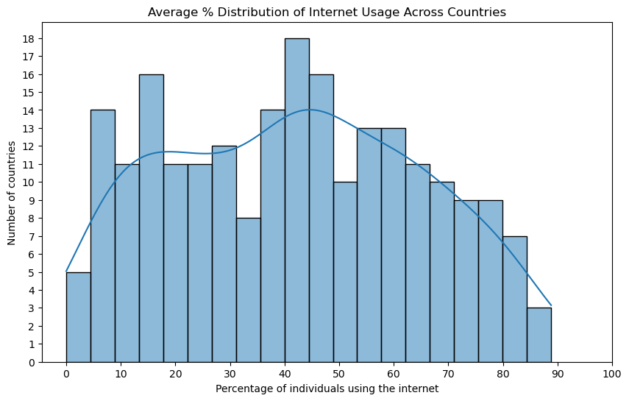
How does the data distribution of internet usage percentages change over the years

Slide 9
How has the global percentage of individuals using the internet changed over time.

Slide 10
Which regions or countries have shown the most significant increase in internet usage
Country | Avg. Growth Rate
Tajikistan | 19.15
Azerbaijan | 14.09
Albania | 11.02
Libya | 10.54
Sudan | 9.51
Myanmar | 7.91
Viet Nam | 7.3
Yemen | 7.11
Timor-Leste | 7.02
Nigeria | 6.41
Top 10 countries with the highest average growth rate

Slide 11
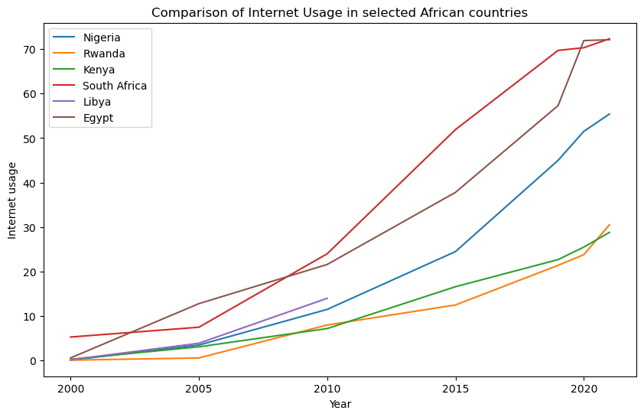
Are there any countries or regions that show unusually high or low internet adoption rates compared to their neighbors or global averages

Slide 12

Thank you

